Slide 1
Service and SOA Concepts

Slide 2
Outline
Objectives
On completing this module, you will be able to:
Understand the benefits of exposing and using functionalities through standard interfaces
Know the concept of a service and a microservice
Know the concept of Service-Oriented Architecture (SOA)
Know the concept of building an enterprise solution as an assembly of (micro)services
Topics
(Micro)Service
SOA

Slide 3
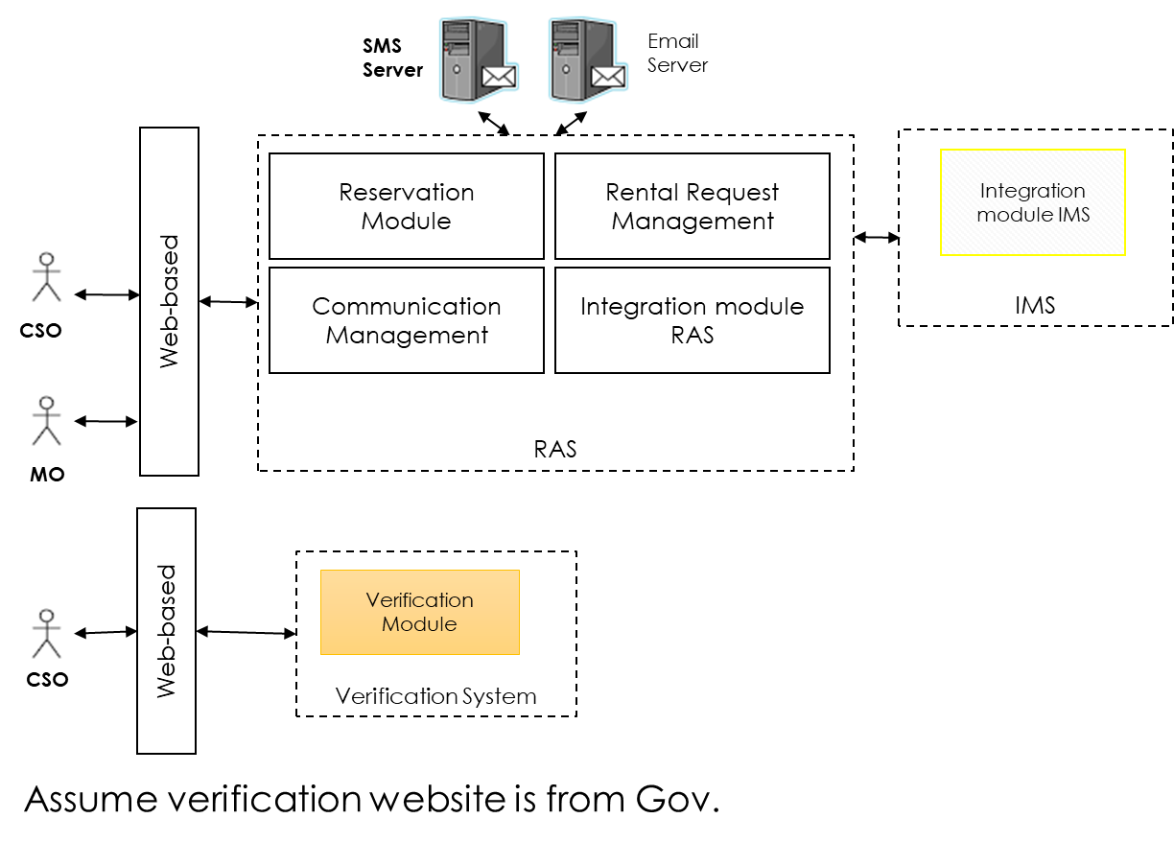
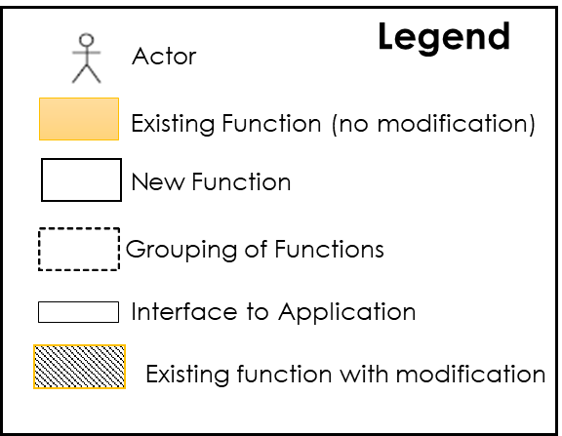
Sample Monolith: Star Mall Solution Overview

Slide 4
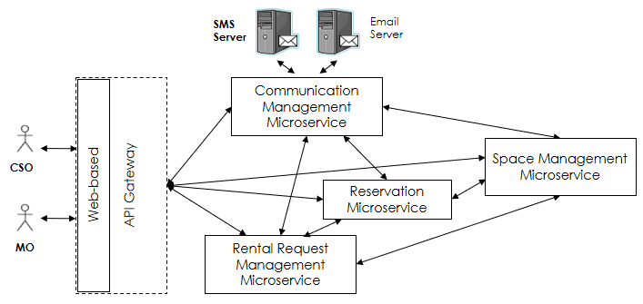
Sample Microservices Architecture for Star Mall

Slide 5
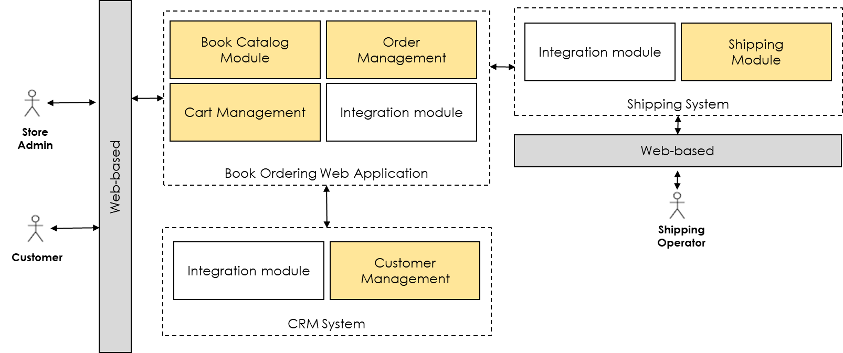
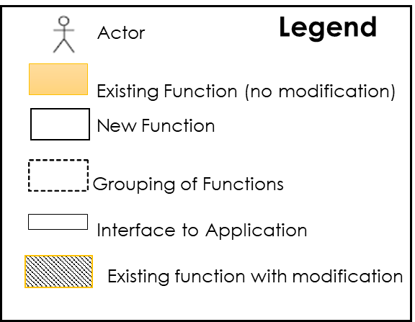
Sample Monolithic Bookstore Solution Overview

Slide 6
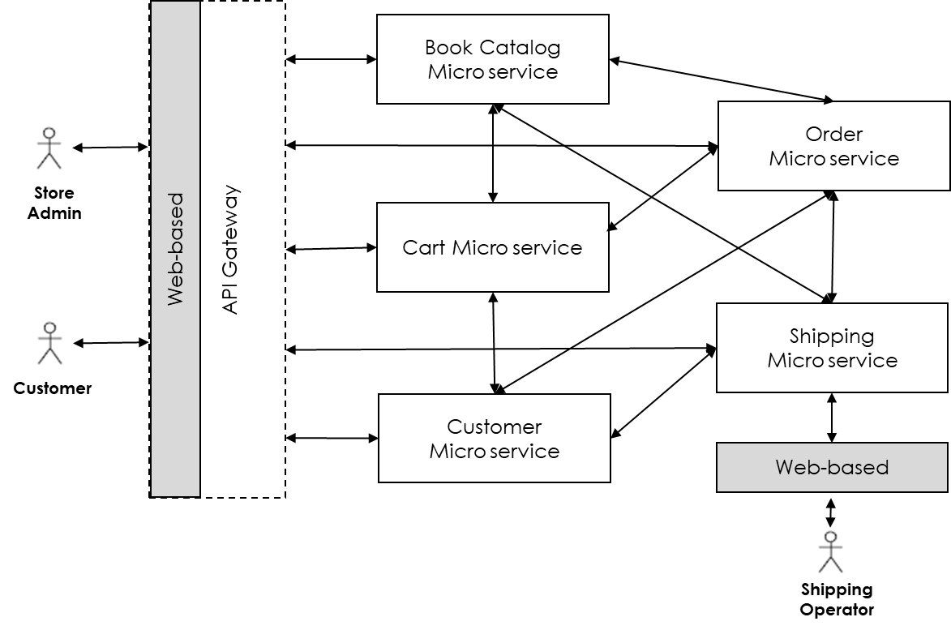
Sample Microservices Architecture for A Bookstore

Slide 7
Benefits of Using Standard Interfaces
Enable more convenient data exchange among different enterprise applications by using commonly used data formats and communication technologies across platforms and networks
E.g., JSON over HTTP transport
Language and platform agnostic
Applications become less coupled with each other
Different applications can be developed and deployed with different technologies
All kinds of applications, including legacy ones, can be made more easily compatible with others, through standardized integration modules, adaptors, connectors, plug-ins, wrappers, etc.
Notes:
The "interfaces" here refer to application programming interfaces (APIs) intended for programs to use/call/invoke, instead of user interfaces which are often intended for human users.

Slide 8

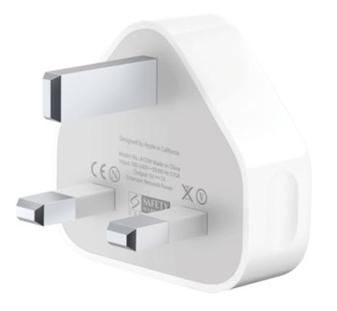
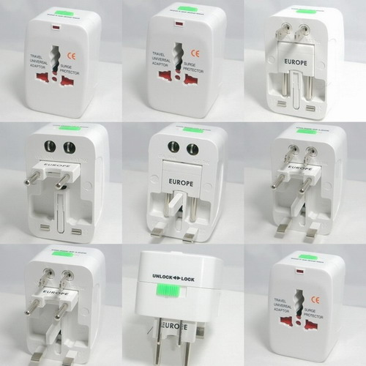
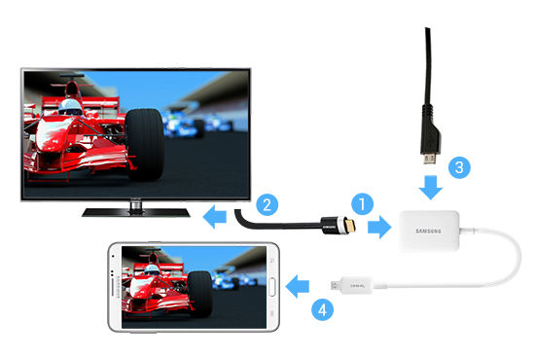
Plug-in? Adapter? Connector? – An Analogy
Power
HDMI
Micro USB
Courtesy of samsung.com
Notes:
We treat these terms interchangeably in this course and ignore their internal technical details that may differentiate them in different contexts in the real world.
* These can all be APIs, or simply interfaces, in the context of software development.
* If these APIs/interfaces follow certain standards, they can then be called services (e.g., a plug-in service, an adapter service, a connector service, a wrapper service).
* In this course, we assume they are all services when we use the terms plug-ins/adapters/connectors/wrappers.

Slide 9
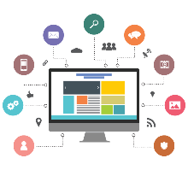

Definition of a Service in the Software World
A service may be defined as:
A unit that provides one or many functionalities needed to support business requirements and can be used by other applications or services over the network via a standard interface that is independent of programming languages and platforms
Input
e.g. search for a book
Service
Consumer
Interface
Service
Provider
Interface
F1
F2
e.g. order a book
Application 2
Output
Application 1
Service Consumer
(consumer)
Service Provider
(server)
The Service Provider Interface and the Service Consumer Interface refer to some code that is at the provider and consumer end respectively and enables data exchange between the provider and the consumer.
Notes:
The unit can be a monolithic application or a mini-application. The application can be a COTS, a custom app, or a legacy app.
The functions in the server are said to be exposed as a service if it provides a standard interface for others to use the functionalities.
Q: is the "hello world" python/flask program in the previous lab a service?
* Web service provides a standard interface that can be used over the web/network.
* Difference between a service and a service interface: the former includes the service interface and the implementation of the functionality (e.g., all the code in the function bodies). From a client/consumer/user's perspective, they don't care about the implementation, so often they may consider a service is the same as a service interface.
* A service provider can be simply called a server, or just service
* A service consumer can be simply called a consumer, client, or user

Slide 10
Sample Order Handling through Service Interfaces (partial, for illustration only)
Order Management System
SCI
SPI
Inventory Management
System
SPI
SCI
SCI
SPI
Packaging & Shipping Management System
SPI- Service Provider Interface
SCI- Service Consumer Interface
Notes:
Interactions happen through the service interfaces (both provider and consumer interfaces), instead of direct function calls of the systems.

Slide 11
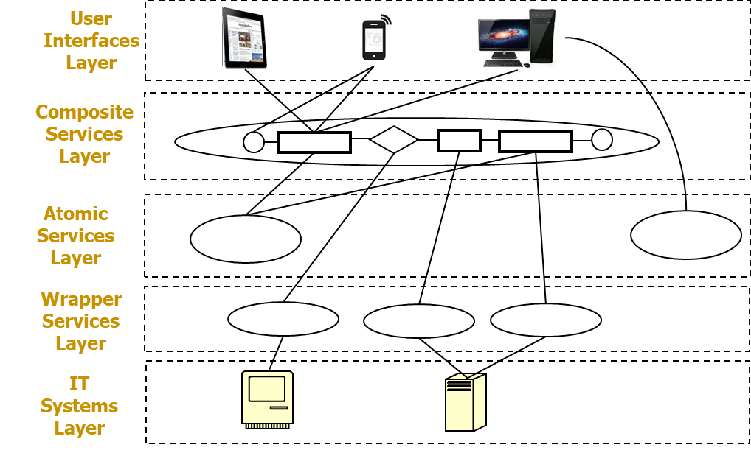
Service-Oriented Architecture
Consider turning all IT systems into services (using wrapper service)
Each service can be small, simple, or large, complex
Develop and maintain enterprise solutions as assemblies of loosely-coupled services
Manage assemblies at various layers of different functionality and/or complexity. Sample layers:
Notes:
The functionality from lower layers can be reused by higher layers, saving the efforts needed to develop the functionalities need by the higher layers.
Each unit in each layer may be developed and maintained by different teams.
The type of wrapper service is dependent on the type of IT system

Slide 12
Microservices (from previous week)
A microservice may be defined as a single unit that implements only one or a few (instead of many) functionality needed to support business requirements and can be used by other applications (or microservices) over the network in a standard interface that is independent of programming languages and platforms
Microservices are "loosely coupled" with each other
It can be implemented in a programming language of its own;
E.g., one microservice is implemented in Java; the other in Python;
It can be deployed and run on a platform of its own;
E.g., one microservice runs on Windows; the other on Linux;
It usually has its own data store when a data store is needed;
E.g., an Order microservice has its own database with an Order table; a Customer microservice has its own database with a Customer table
It can be scaled independently
E.g., instances of the same microservice that is more frequently used than others can be deployed to many machines to support concurrent processing
Its implementation can be changed independently, as long as its interface for invocation remains the same
Notes:
Service has one or many functionalities while microservice has only one or a few functionalities

Slide 13
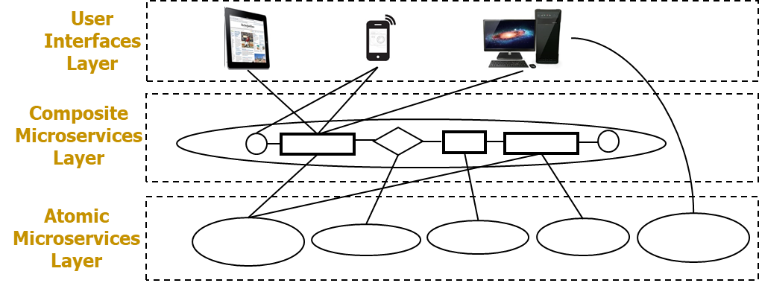
Microservices and MSA Revisit
A microservice may be defined as:
A service that can be independently developed and deployed and provides one or a few functionalities needed to support business requirements
Develop and maintain enterprise solutions as assemblies of loosely-coupled microservices
Provide all functionalities needed as microservices
Each microservice is relatively small, simple
Sample SOA layers with microservices:
Notes:
A service can be considered as a microservice if the code implementing the functionality of the service is NOT monolithic and can be easily deployed and scaled.
Q: is the "hello world" python/flask program in the previous lab a microservice too?
Is the google custom search API (cf. https://developers.google.com/custom-search/v1/using_rest) a service and/or a microservice? Is it a REST web service too?
Why is there no IT systems and wrapper service for microservices?
Everything here is small but if there is IT systems layer it will be very big and complex as many wrapper services are needed to convert IT systems to atomic services so we just start with atomic microservices

Slide 14
Types of (Micro)Services
Atomic (Micro)Service
“Atomic” implies that the (micro)service implements the expected functionalities by itself independent of other (micro)services or applications within an enterprise context (except for commonly used applications, such as Apache HTTP server, MySQL server)
An atomic microservice is often simple, providing one or a few functionality related to one kind of entity of a business concern (e.g., Book, Customer, etc.); the operations provided by the microservice are often simple CRUD of the data entities.
An atomic service may be complex, providing many functionalities involving multiple kinds of entities, which is not recommended by Microservices Architecture.
Wrapper Service
It usually does not provide new functionalities; it mainly exposes some functionalities of another application (e.g., a legacy system, an external system) as a service.
Composite (Micro)Service
“Composite” implies that the (micro)service implements the expected functionalities by composing a set/sequence of other services or applications together according to a business process (e.g., Place an order, Process a shipping record, Restock inventory)
The composition is often implemented via inter-process communication (IPC) technologies
A composite (micro)service are often called process (micro)service as it is often used to implement a business process involving more than one kinds of data entities.
A composite microservice may use other (micro)services, but not a monolith directly.
A composite service may use other (micro)services or a monolith directly, which is not recommended by Microservices Architecture
Notes:
An “atomic“ (micro)service often means a self-contained single unit that may not be further broken down into smaller units to be beneficial for an enterprise.
It usually implements simple functionalities involving one kind of data entity.
It may not be completely self-contained; it can still depend on some other commonly used applications, e.g., MySQL, HTTP servers, as long as those applications are considered to be scalable and can be independently deployed and would have little impact on the implementation and deployment of the atomic (micro)service.
It may not invoke other (micro)services via HTTP, as invoking others would mean it depends on others' URLs;
It may not directly communicate to other (micro)services (later lectures will have more details about inter-process communication technologies (IPC))
it may still send reply data if requested; e.g., respond to an HTTP request, or send a reply message via AMQP
it may still send data out (e.g., publishing a message/event via AMQP), but should not need to directly know who the receivers are; the data sent out should not directly contain the receivers' information;
A “composite“ (micro)service often means some functionality that is composed from other (micro)services. The composition of (micro)services is often implemented via IPC, not via normal function calls.
It often involves functionalities that correspond to business processes, which are usually more complex than atomic (micro)services.
It invokes other (micro)services via HTTP, or directly communicates to others, e.g., by sending a request to a particular receiver and waiting for a reply
A composite (micro)service often needs to know the interfaces (e.g., URLs, routing keys, data formats) of all others it communicates with.
Composing directly with a monolith without a service interface is not recommended (although technically can be done), as that would increase coupling between the composite service and the monolith, making it harder to deploy/scale up the service independent of the monolith.
A better way is to first expose the monolith's functionality as a set of wrapper services, then build a composite microservice that indirectly composes the monolith via using those wrapper services.

